Slide 1
MULTI-CUT REBAR(10)
Advisor : Prof. K.C.Chang
Presenters : You-Ran Nai
Notes:
試試看暫停一下

Slide 2
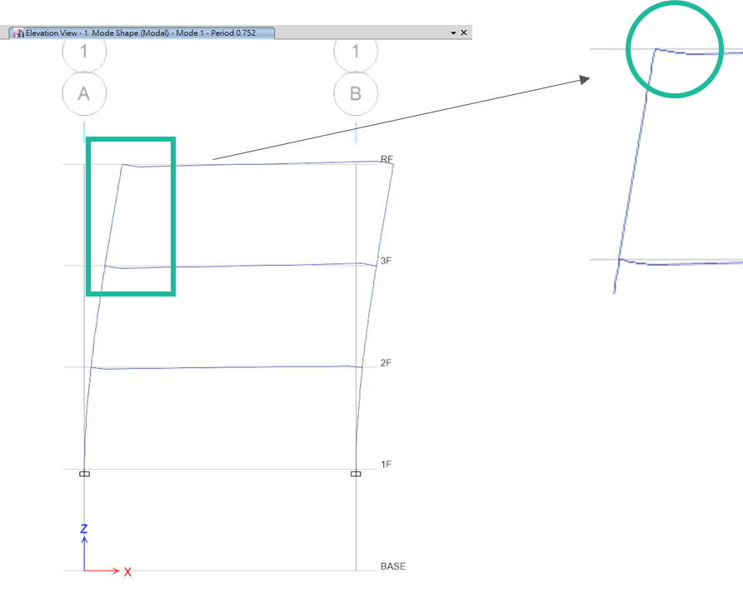
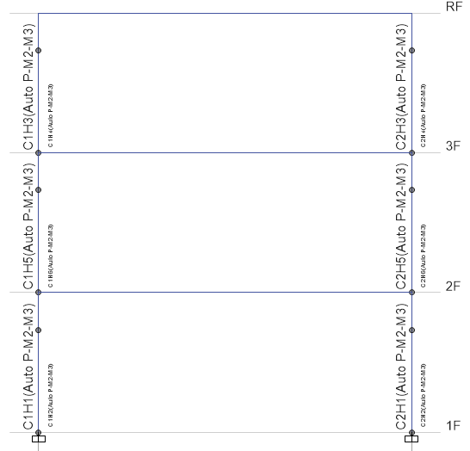
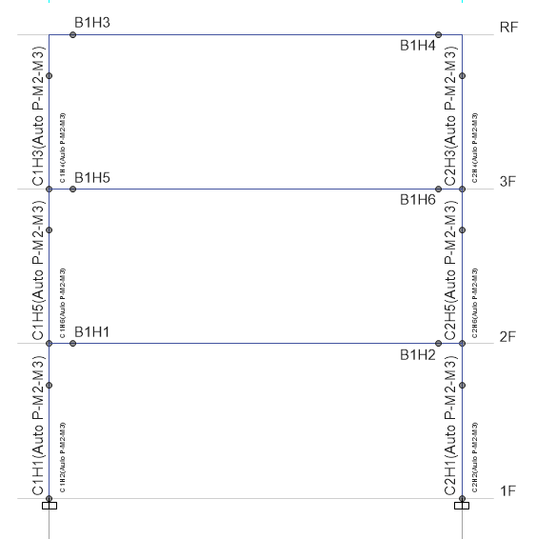
Nonlinear Hinge
ETABS 2016
No Nonlinear Beam Hinge
T=0.345
Nonlinear Beam Hinge
T=0.752
Nonlinear Beam Hinge
Notes:
李森蚺

Slide 3
Nonlinear Hinge
Static Nonlinear
Fast Nonlinear Analysis (FNA) Modal Time History Analysis
Nonlinear Direct Integration Time History

Slide 4
P-Delta
ETABS 2016
P-Delta
No P-Delta
No Nonlinear Beam Hinge
T=0.345
No Nonlinear Beam Hinge
T=0.344
Nonlinear Beam Hinge
T=0.752
Nonlinear Beam Hinge

Slide 5
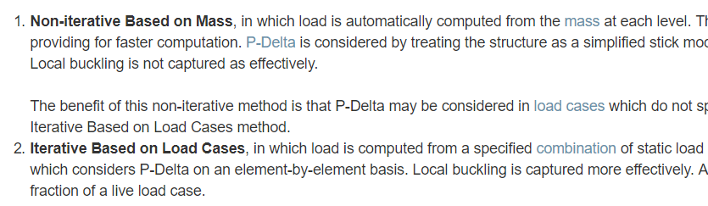
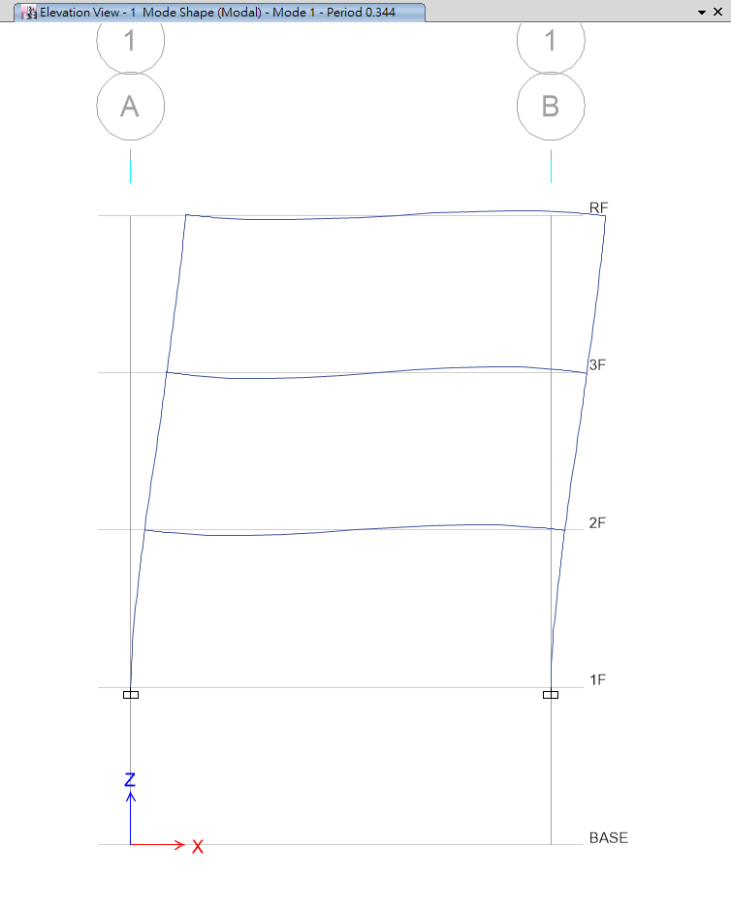
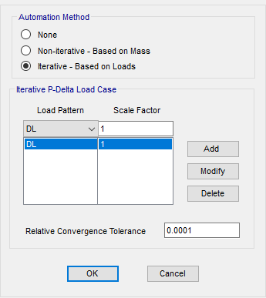
P-Delta
Local Buckling
RC ➔ SS

Slide 6
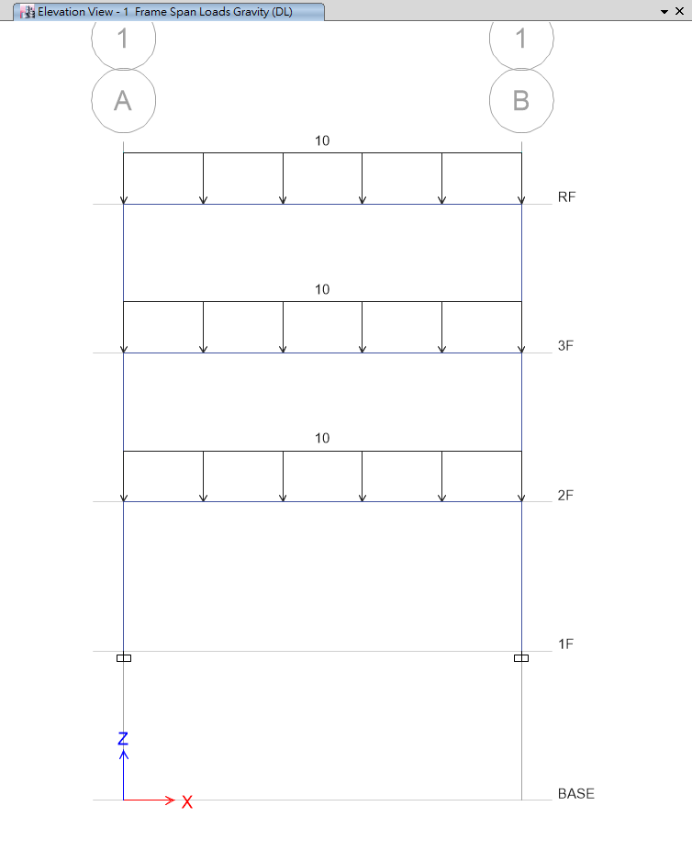
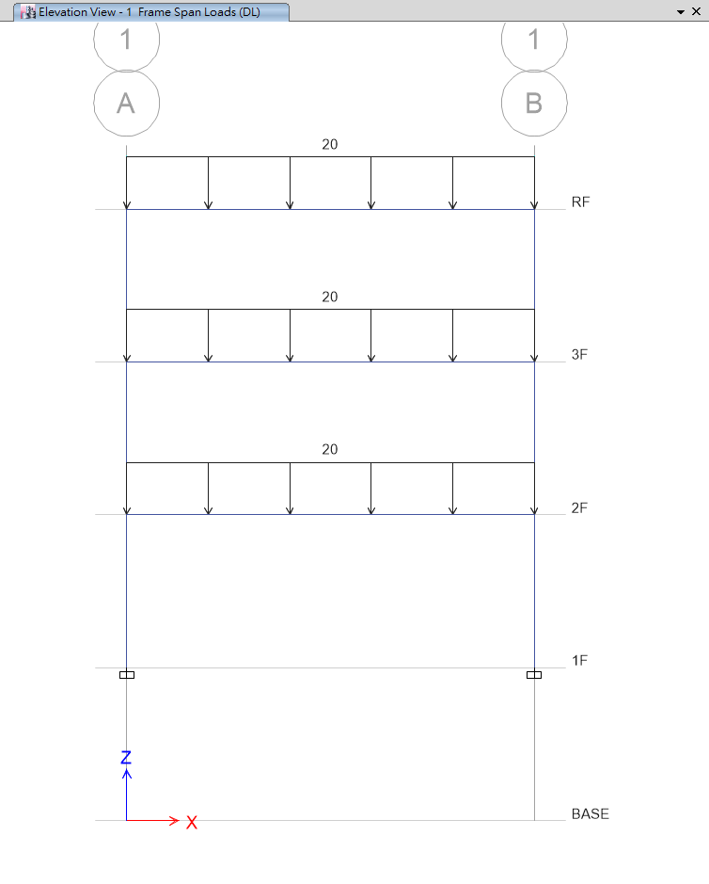
P-Delta
Steel Structure
10 ton/m
Same Period
20 ton/m
Different Period

Slide 7
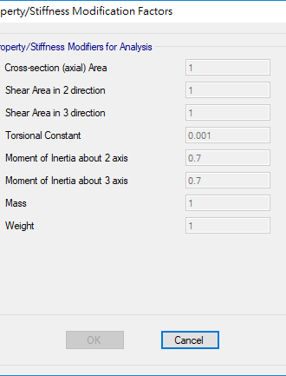
0.5, 0.7
Moment of Inertia
Same Problem
Notes:
總結

Slide 8
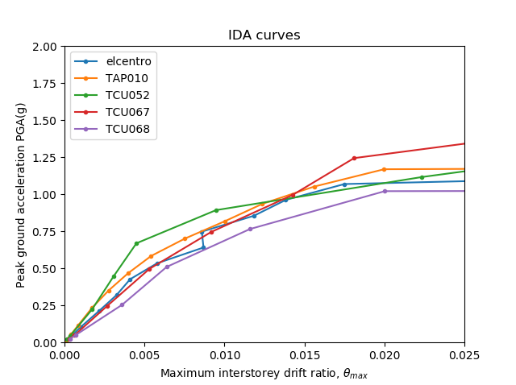
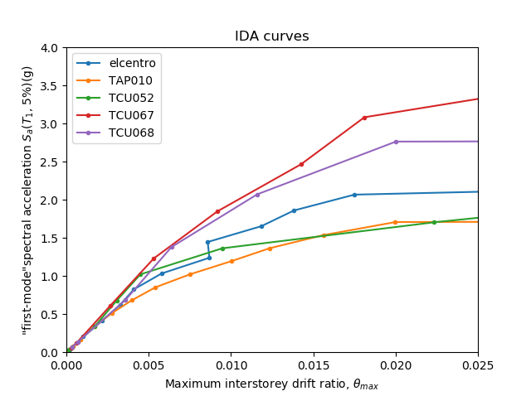
PGA versus Sa(T₁, 5%)
Less Dispersion

Slide 9
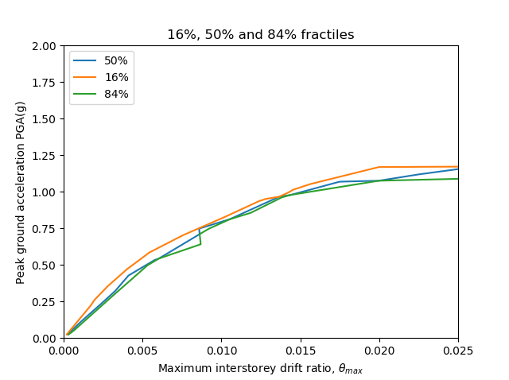
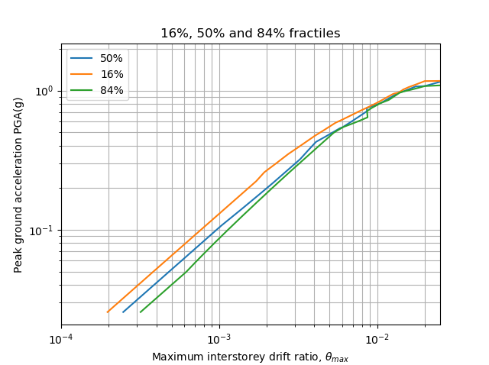
Linear
Log

Slide 10
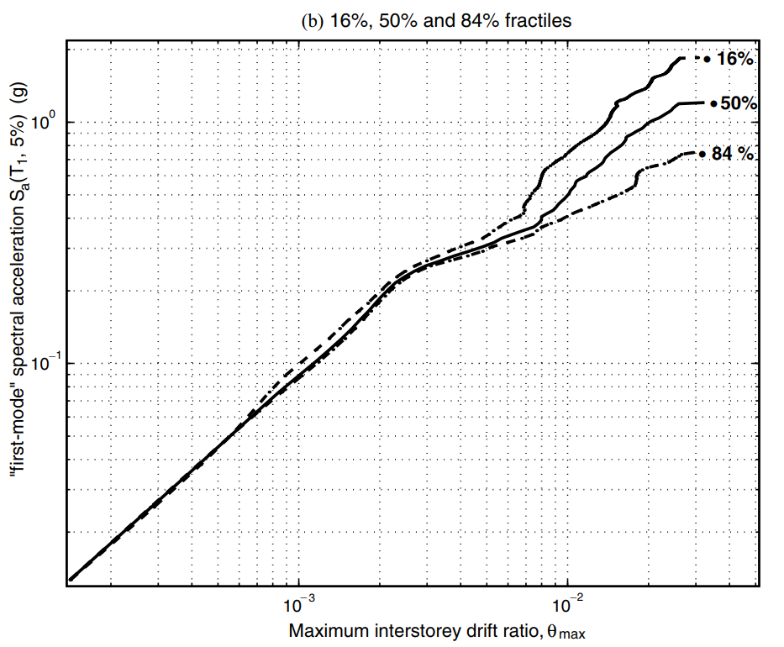
5-storey steel braced frame
3-storey rc moment resist frame
Elastic Closed

Slide 11
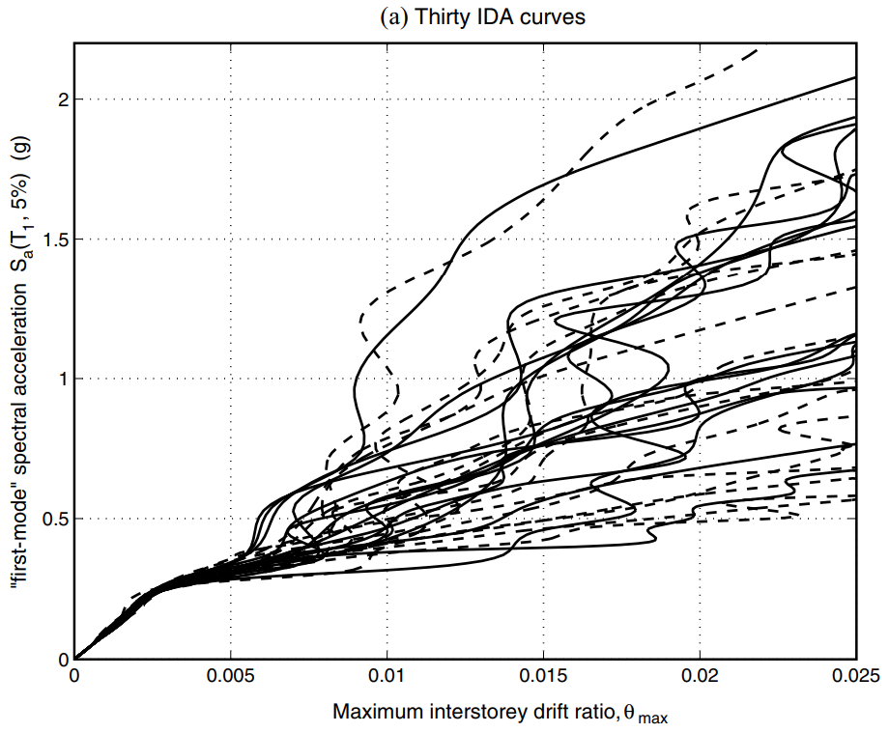
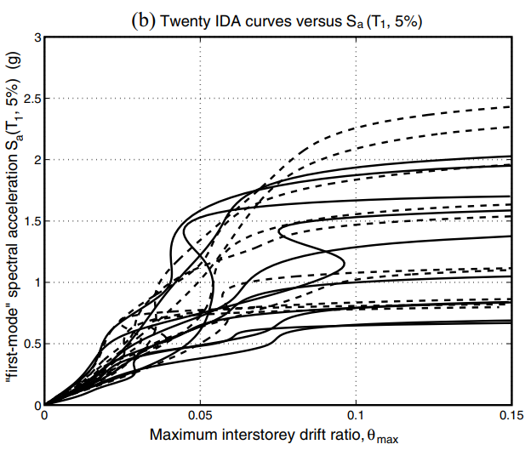

Slide 12
PGA versus Sa(T₁, 5%)
Less Dispersion
Elastic Closed

Slide 13
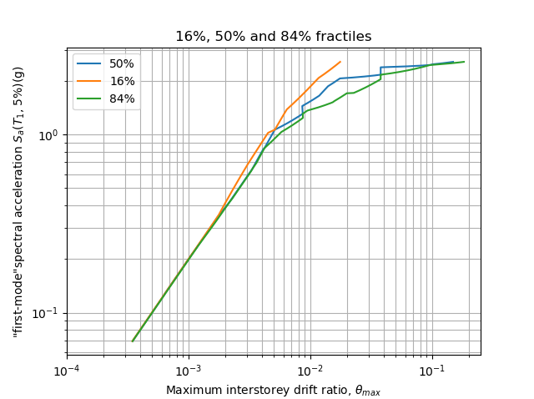
5-storey steel braced frame
3-storey rc moment resist frame
Elastic Closed

Slide 14
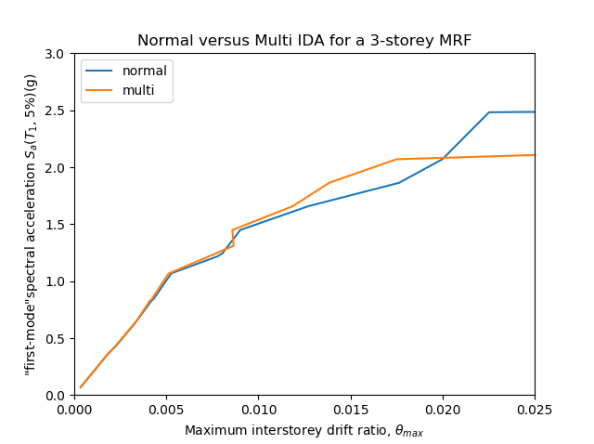
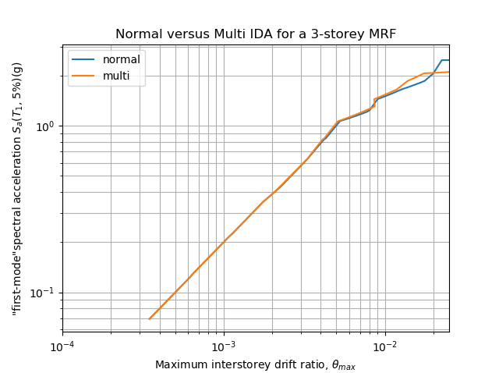
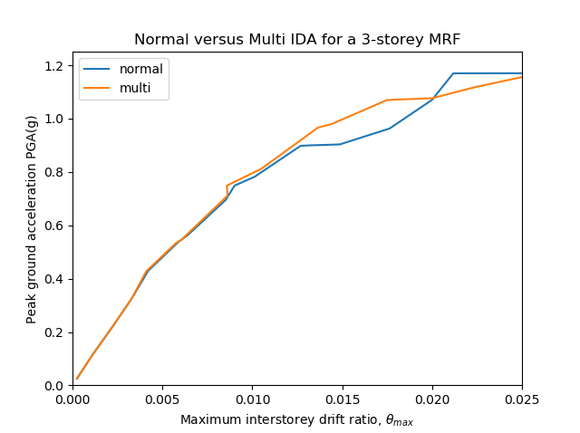
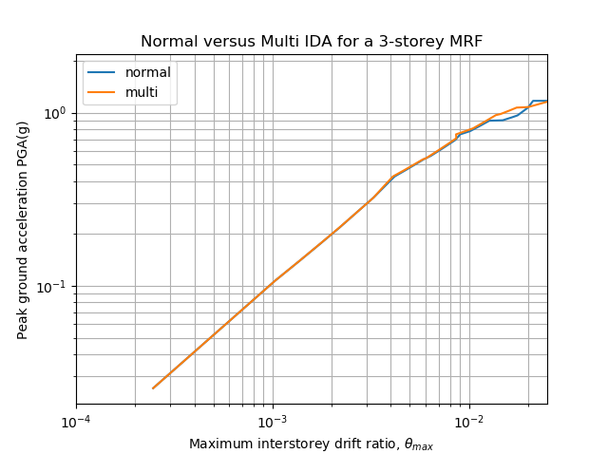
Sa(T₁, 5%)
PGA

Slide 15
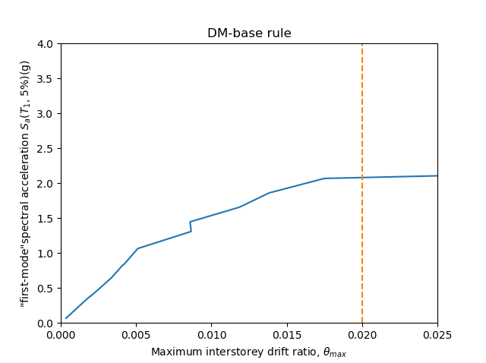
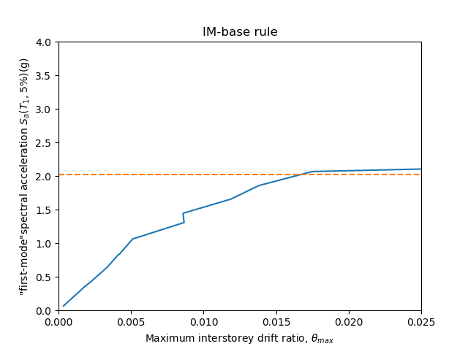
C_{DM} is set at 0.02
C_{IM} uses the 20% slope criterion

Slide 16
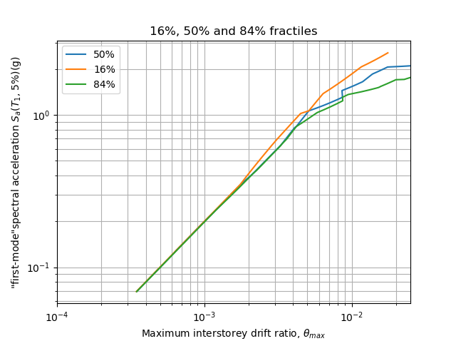
3-storey rc moment resist frame
P-Delta ➔ No P-Delta
Consider Structural Resurrection
➔ No Consider Structural Resurrection
Rough ➔ Detail ( Output Size, Scaled Factor… )
Elastic Closed

Slide 17
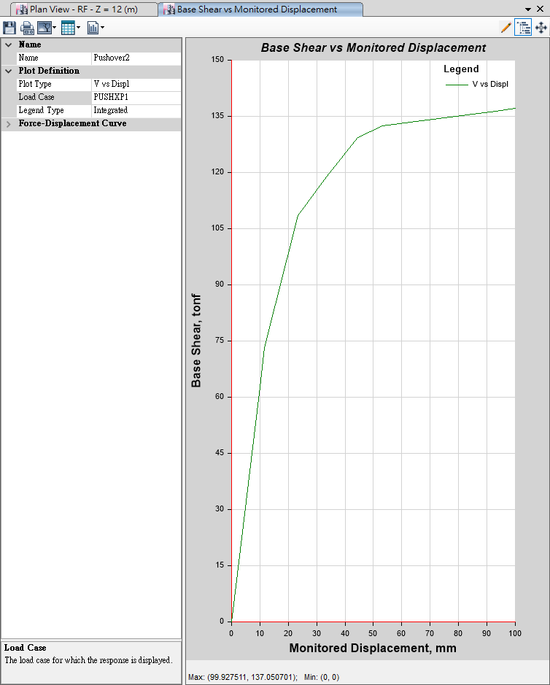
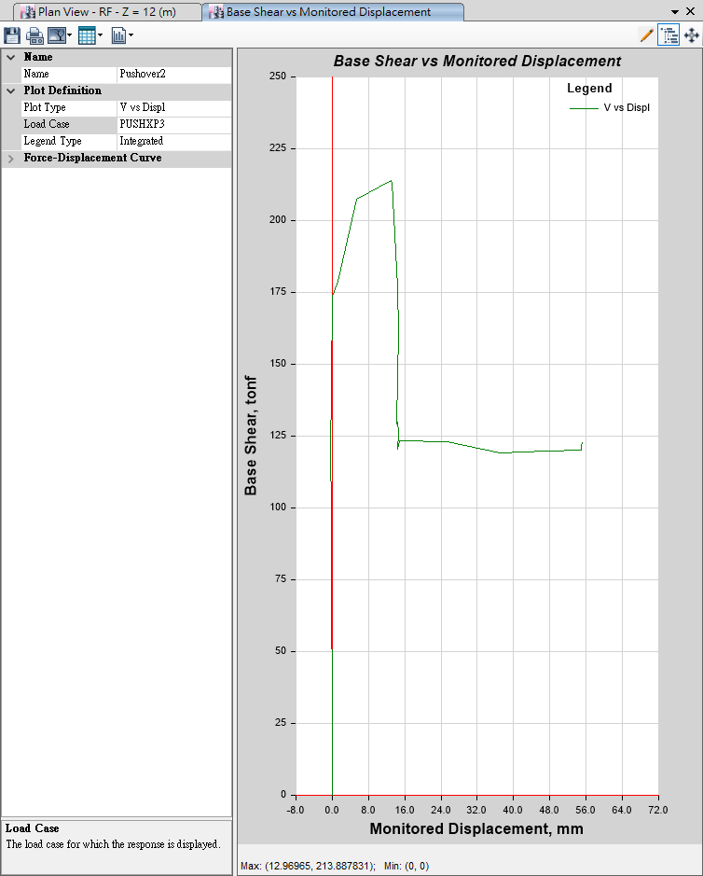
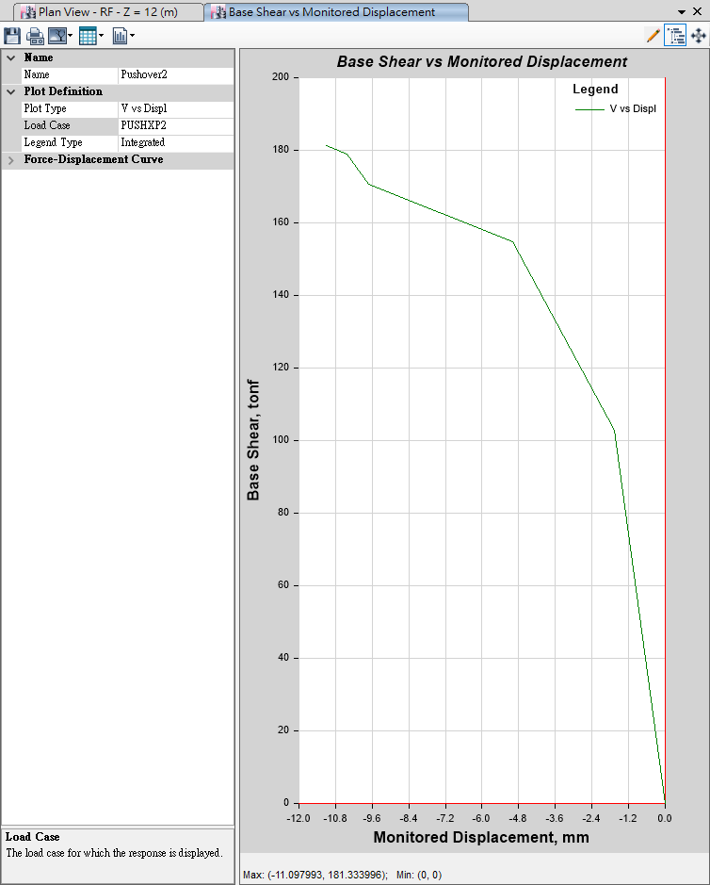
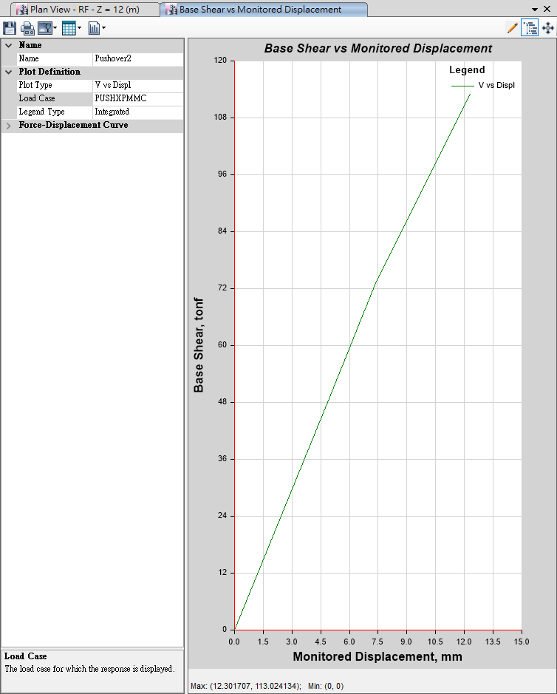
Pushover
Mode 1
Mode 3
100mm
10mm
Mode 2
MMC
10mm
10mm

Slide 18
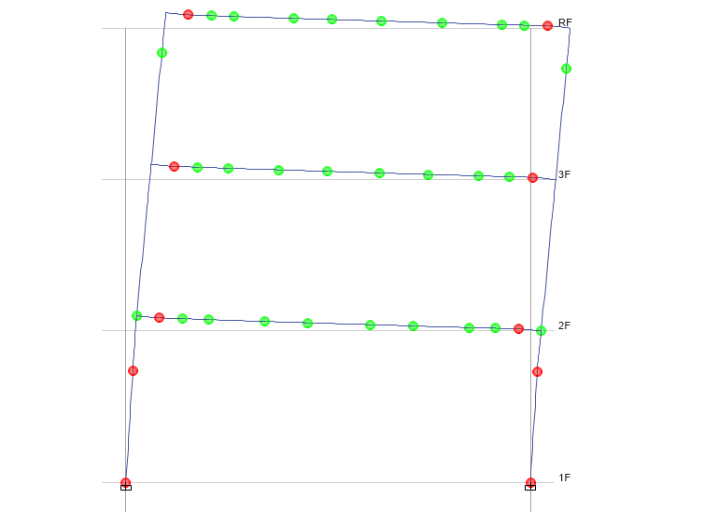
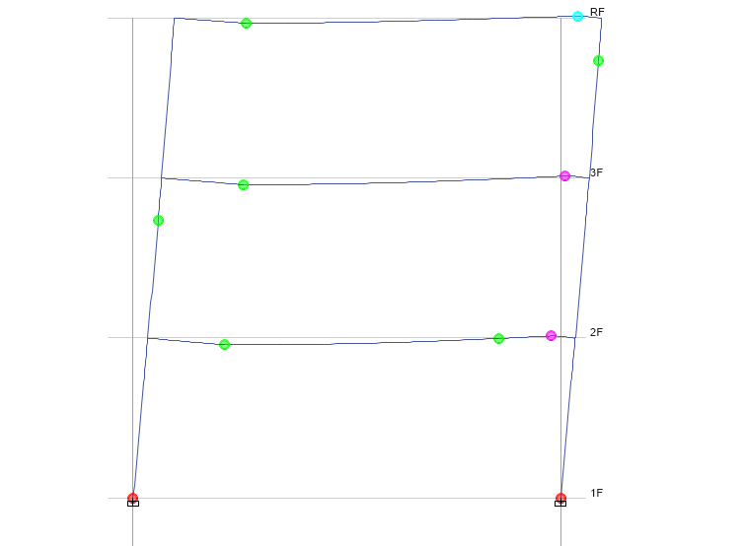
Time History
Pushover
No Middle Hinge

Slide 19
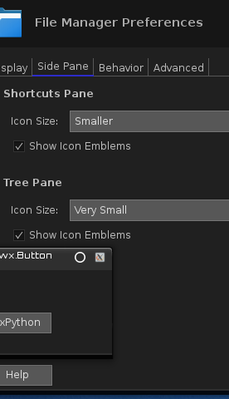
LinearCut GUI

Slide 20
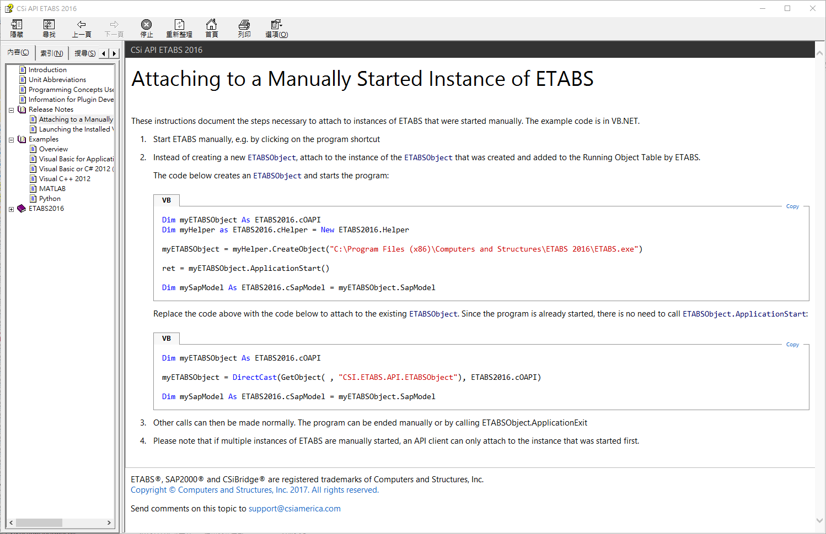

Slide 21
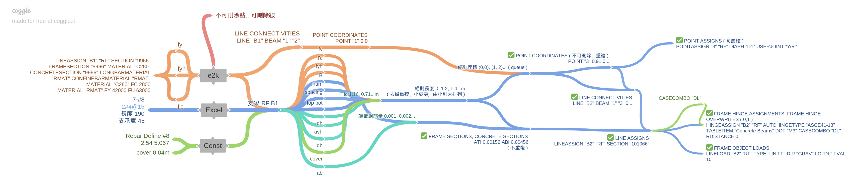
E2K versus API

Slide 22
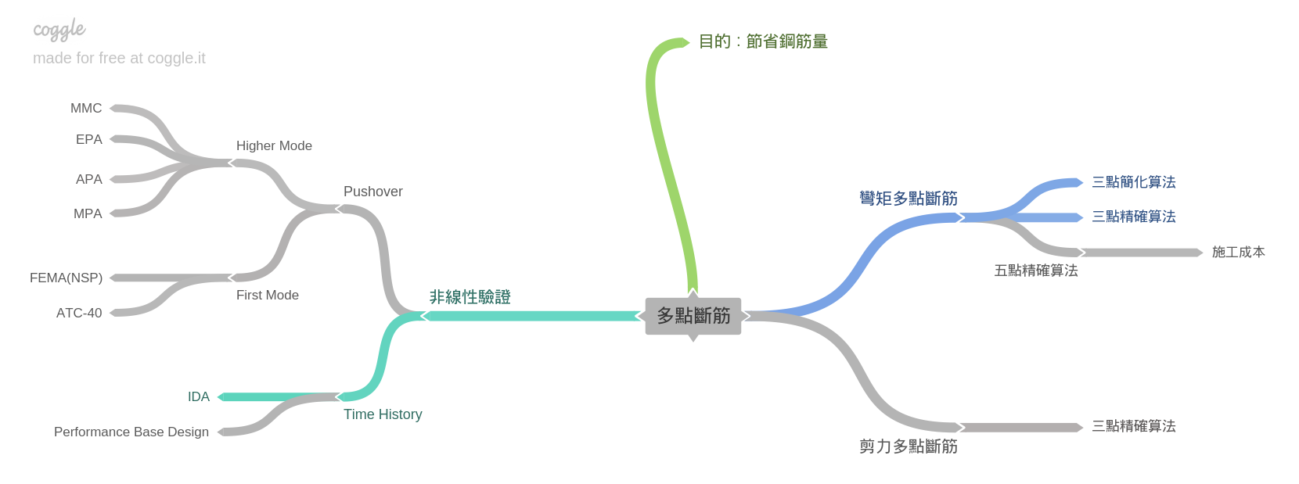
Roadmap
GUI
Nonlinear Hinge

Slide 23
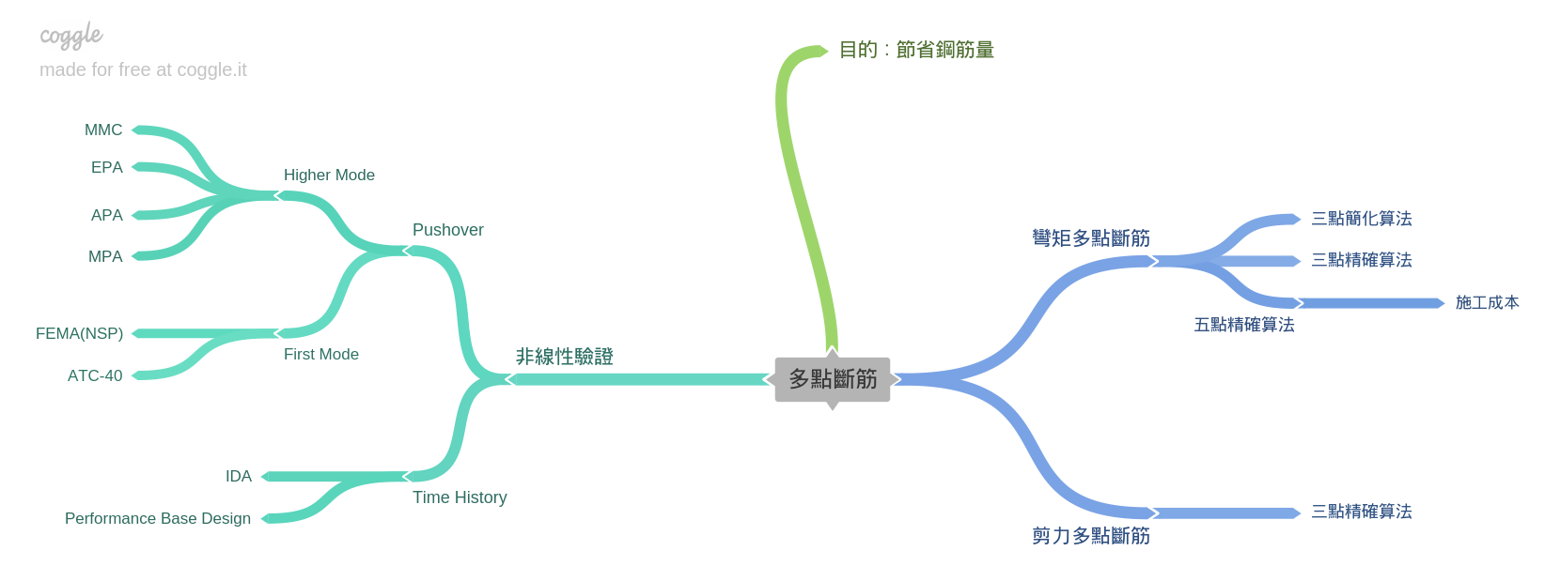
Roadmap

Slide 24
